Slide 1
IEC 61400-12-1 FDIS 2016 Consensus Analysis Project
Lee Cameron
December 13, 2016

Slide 2
Contextual Introduction
IEC 61400-12-1: “Power Performance Measurements of Electricity Producing Wind Turbines”
Last published in 2005. New issue due in beginning of 2017.
Remote Sensing Devices
Only met masts were allowed previously
Rotor Equivalent Wind Speed
To correct for the influence of shear
Turbulence Renormalisation
To correct for the influence of turbulence
Many changes to the uncertainty method to reflect these changes in instrumentation and method
Lots of other small changes
Relative humidity influence on density, statistical uncertainty due to site calibration considered, changes to anemometer classification, etc.

Slide 3
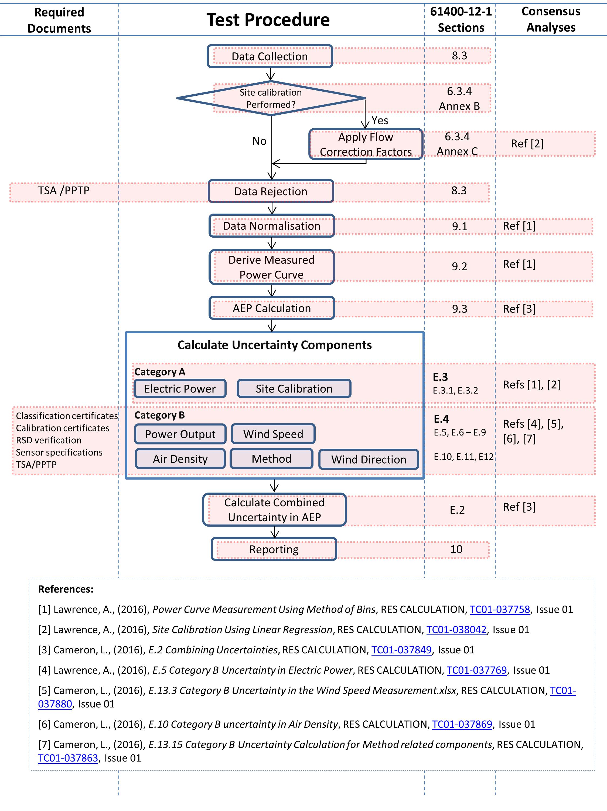
Power Performance Test Procedure
Notes:
Data normalisation = density, turbulence and shear corrections

Slide 4
Project Aim
In this project we aim to demonstrate the proper implementation of the new IEC power performance testing standard, with focus on the uncertainty calculation.
We aim to do this by creating a collection of Excel spreadsheet calculations for key sections.
The calculations will be modular in structure, each showing the method for a small section.

Slide 5
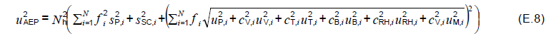
Power Curve Uncertainty Calculations
Uncertainty combination
Equation E.8 in the standard gives the method for combining separate uncertainty contributions to give overall uncertainty
This is the AEP uncertainty. It is what we need to calculate!

Slide 6
Power Curve Uncertainty Calculations
Uncertainty combination
Equation E.8 in the standard gives the method for combining separate uncertainty contributions to give overall uncertainty
Hours in a year. This turns our uncertainty in power into and uncertainty in energy

Slide 7
Power Curve Uncertainty Calculations
Uncertainty combination
Equation E.8 in the standard gives the method for combining separate uncertainty contributions to give overall uncertainty
Many components vary with wind speed so the combination is performed across all bins of the power curve

Slide 8
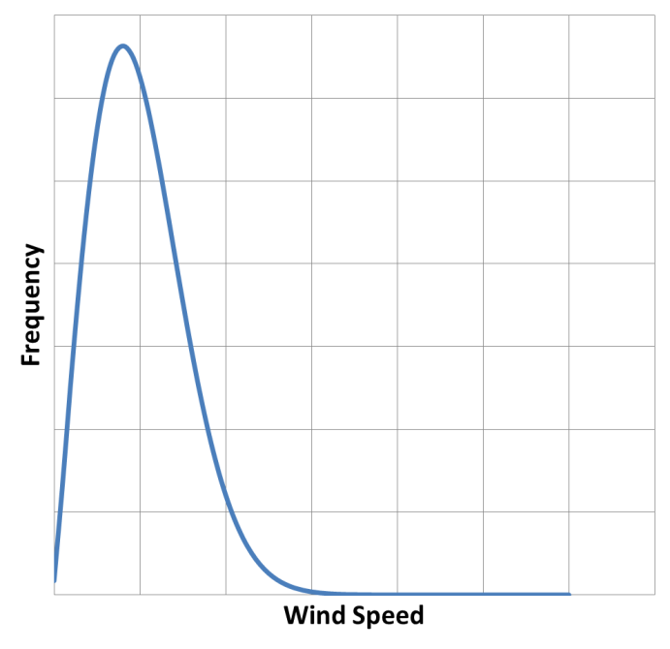
Power Curve Uncertainty Calculations
Uncertainty combination
Equation E.8 in the standard gives the method for combining separate uncertainty contributions to give overall uncertainty
Relative occurrence of each wind speed bin (to account for long term wind speed distribution)

Slide 9
Power Curve Uncertainty Calculations
Uncertainty combination
Equation E.8 in the standard gives the method for combining separate uncertainty contributions to give overall uncertainty
Category A uncertainties
Statistical uncertainties, based on the data. Due to statistical scatter, do not account for potential bias.
Category B uncertainties
To reflect potential bias in instrumentation and due to methodology.

Slide 10
Power Curve Uncertainty Calculations
Uncertainty combination
Equation E.8 in the standard gives the method for combining separate uncertainty contributions to give overall uncertainty
Category A uncertainties
Statistical uncertainties, based on the data. Due to statistical scatter, do not account for potential bias.
Category B uncertainties
To reflect potential bias in instrumentation and due to methodology.
We have a made spreadsheet demonstrating the calculation of each category A and B uncertainty component

Slide 11
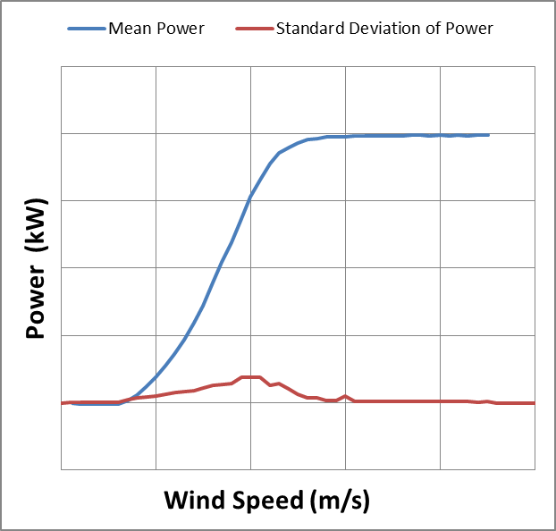
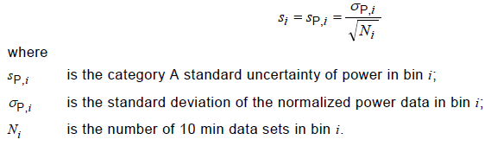
Power Curve Uncertainty Components
Category A - Power
“Power Curve Measurement Using The Method of Bins.xlsx”
Simple and well understood
Related to the standard deviation in each power curve bin

Slide 12
Power Curve Uncertainty Components
Category A - Site Calibration
“Site Calibration Using Linear Regression.xlsx”
New in this issue of the standard
Based on “K-Fold Analysis”:
Break the site calibration filtered dataset into 10 subsets (“folds”)
Predict turbine mast wind speed for each subset using the calibration data from the other 9 folds
Uncertainty is based on the standard deviation of prediction error in each fold

Slide 13
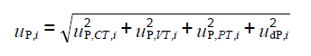
Power Curve Uncertainty Components
Category B - Power
“E.5 Category B Uncertainty in Electric Power.xlsx”
Uncertainties due to:
Current and voltage transformers
Power transducer
Data acquisition
Depends on the classification of voltage and current transformers
IEC 60044-1 gives uncertainties for different class of current transformers
IEC 60688-1 gives uncertainties for different class power transducers

Slide 14
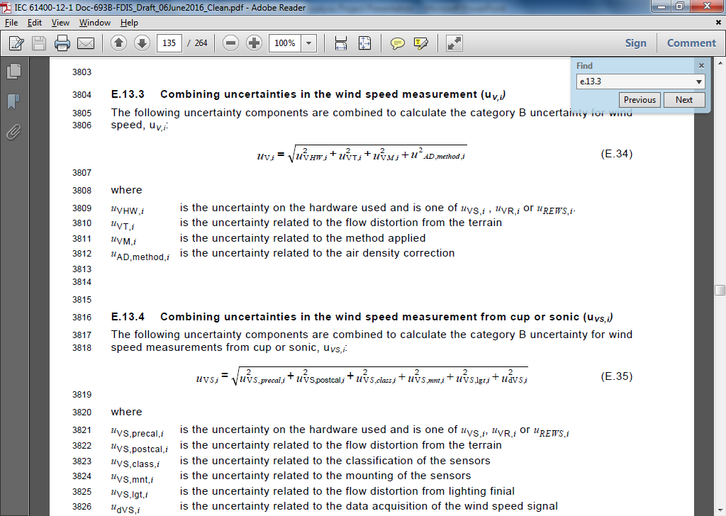
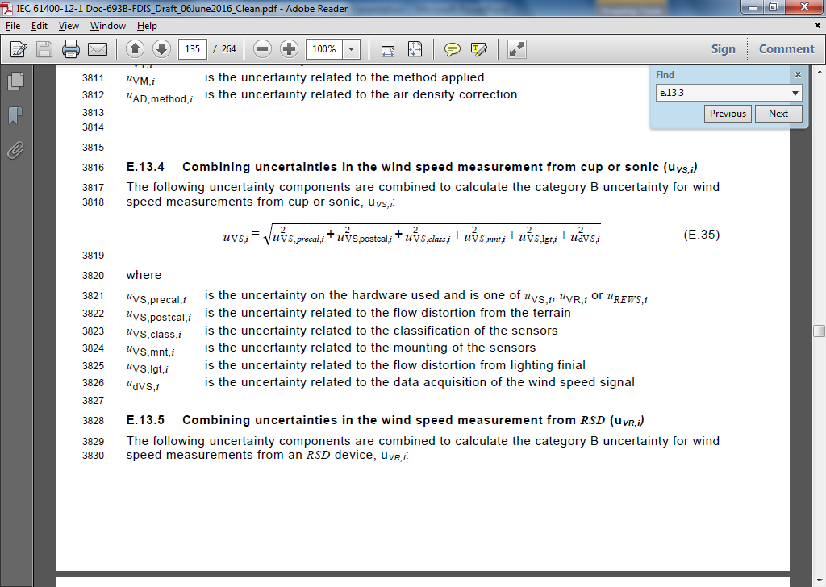
Power Curve Uncertainty Components
Category B – Wind Speed
“due to hardware used”, i.e. WS measurement instrumentation
For cup or sonic anemometer:
Components due to:
Pre-test calibration,
Post-test calibration
Classification
Mounting
Lightning Finial
Data acquisition system
Notes:
REWS is not a piece of hardware, rather it is a definition of wind speed measurement. You can measure this using either mast or RSD in theory, although only RSD is practical.

Slide 15
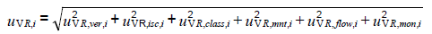
Power Curve Uncertainty Components
Category B – Wind Speed
“due to hardware used”, i.e. WS measurement instrumentation
For RSD:
Components due to:
Verification test vs mast
In-situ comparison to mast
RSD classification
Mounting
Flow variation in the measurement volume
Monitoring of the RSD
Notes:
REWS is not a piece of hardware, rather it is a definition of wind speed measurement. You can measure this using either mast or RSD in theory, although only RSD is practical.

Slide 16
Power Curve Uncertainty Components
Category B – Wind Speed
"E.13.3 Category B Uncertainty in the Wind Speed Measurement.xlsx"
Uncertainties due to:
Hardware used
"E.13.4 Category B uncertainty in wind speed from cup or sonic.xlsx"
"E.13.5 Category B uncertainty in wind speed from RSD.xlsx"
"E.13.6 Category B uncertainty in wind speed from REWS.xlsx"
Terrain
"E.13.11 Category B uncertainty in wind speed from flow distortion due to terrain.xlsx“
Related to the site calibration (or lack thereof)
Air Density Correction
"E.10 Category B uncertainty in Air Density.xlsx"
Related to air density correction
Notes:
REWS is not a piece of hardware, rather it is a definition of wind speed measurement. You can measure this using either mast or RSD in theory, although only RSD is practical.

Slide 17
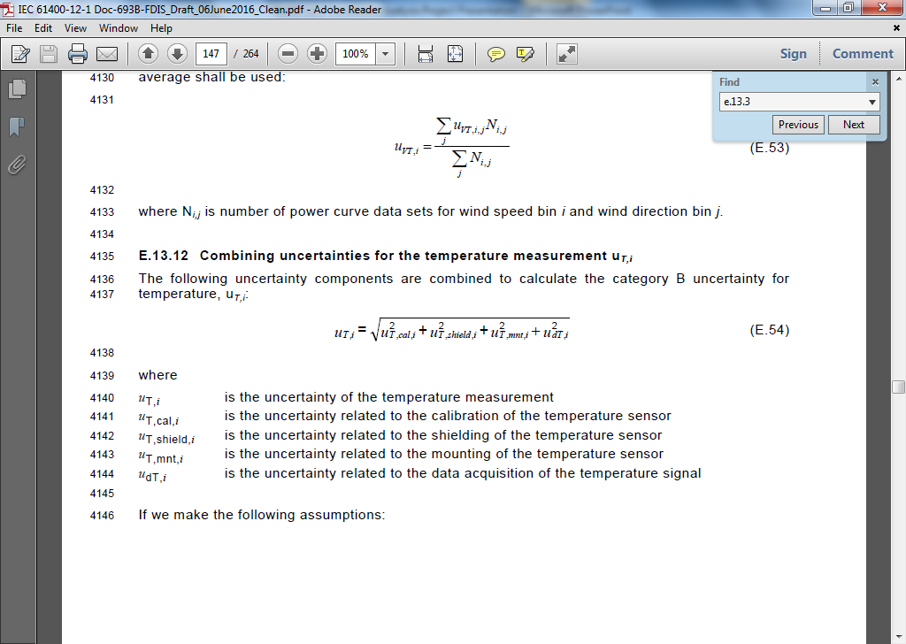
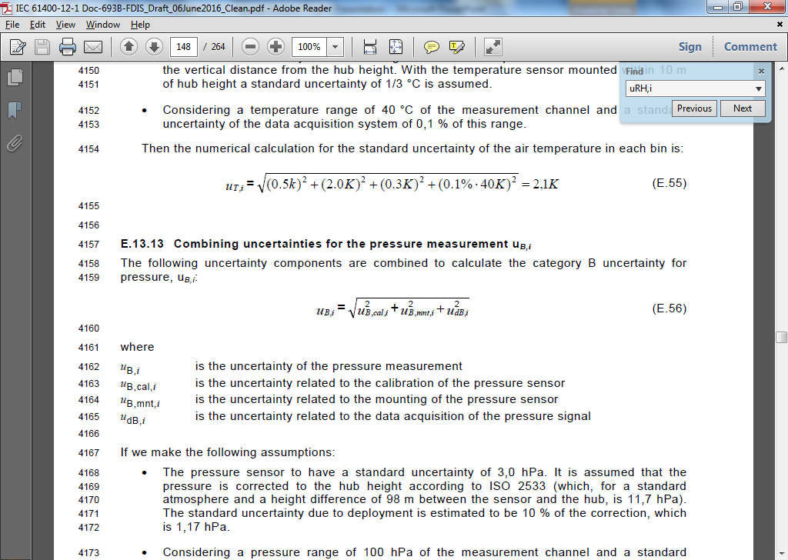
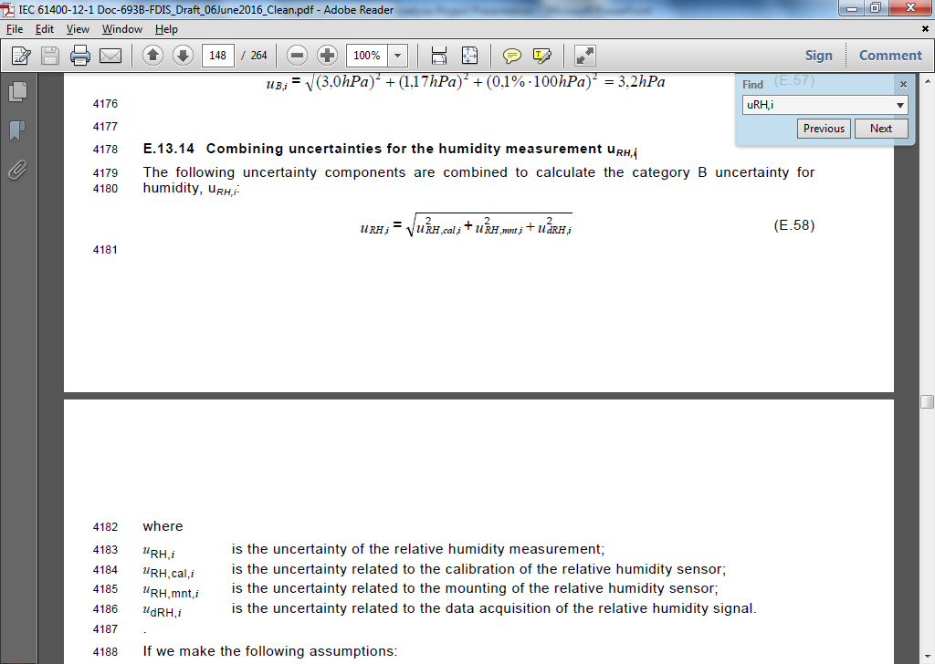
Power Curve Uncertainty Components
Category B – Temperature, Pressure and Relative Humidity
"E.10 Category B uncertainty in Air Density.xlsx"
Relative humidity was not included in the previous standard
Same components, but sensitivity factor has changed in this issue of the standard
All informed by manufacturer specs with extra penalties if measurement is far from hub height
Temperature:
Calibration
Shielding
Mounting
Data acquisition
Pressure:
Calibration
Mounting
Data acquisition
Relative Humidity:
Calibration
Mounting
Data acquisition

Slide 18
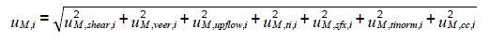
Power Curve Uncertainty Components
Category B – Method related components
"E.13.15 Category B Uncertainty Calculation for Method related components.xlsx"
Many new sub-components in this issue of the standard
Uncertainties due to:
Uncertainty in calculation of wind shear & veer
Uncertainty due to lack of knowledge of upflow angle & turbulence
Uncertainty due to unquantifiable seasonal effects
Uncertainty due to cold climate
Uncertainty due to turbulence normalisation

Slide 19
Power Performance Analysis Procedure

Slide 20
PCWG Feedback
The worked examples have been shared with group members via the PCWG DropBox
A number of issues were pointed out:
Some issues with combination of uncertainties in “E.2 Combining Uncertainties.xlslx”
Further clarification/commentary on some aspects of the methodology
Coverage factor to apply calibration certificates (k=1 for consistency with other uncertainty components)
Other small errors in formulae and captions

Slide 21
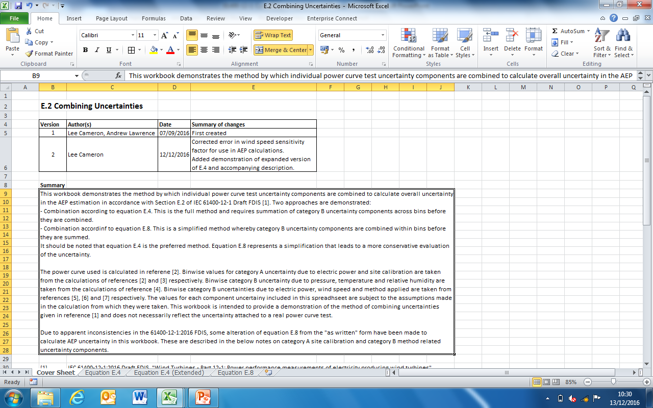
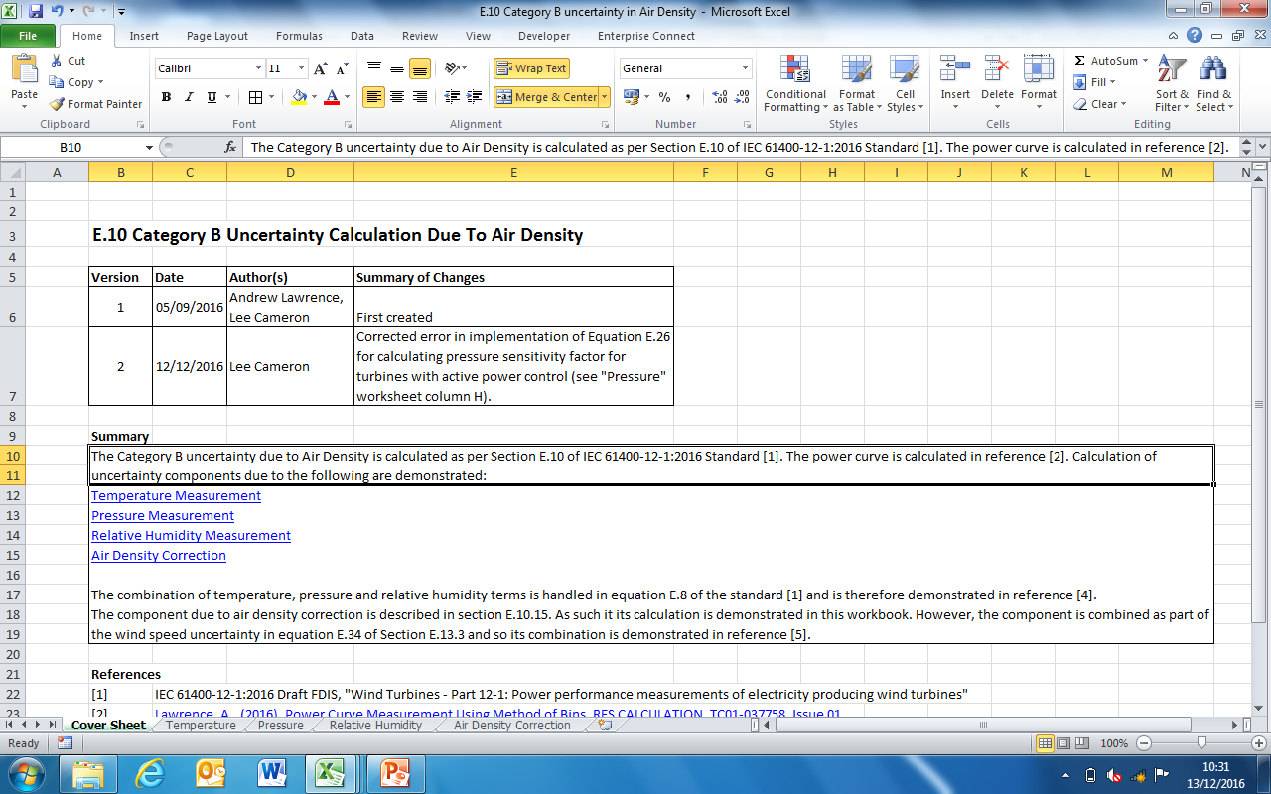
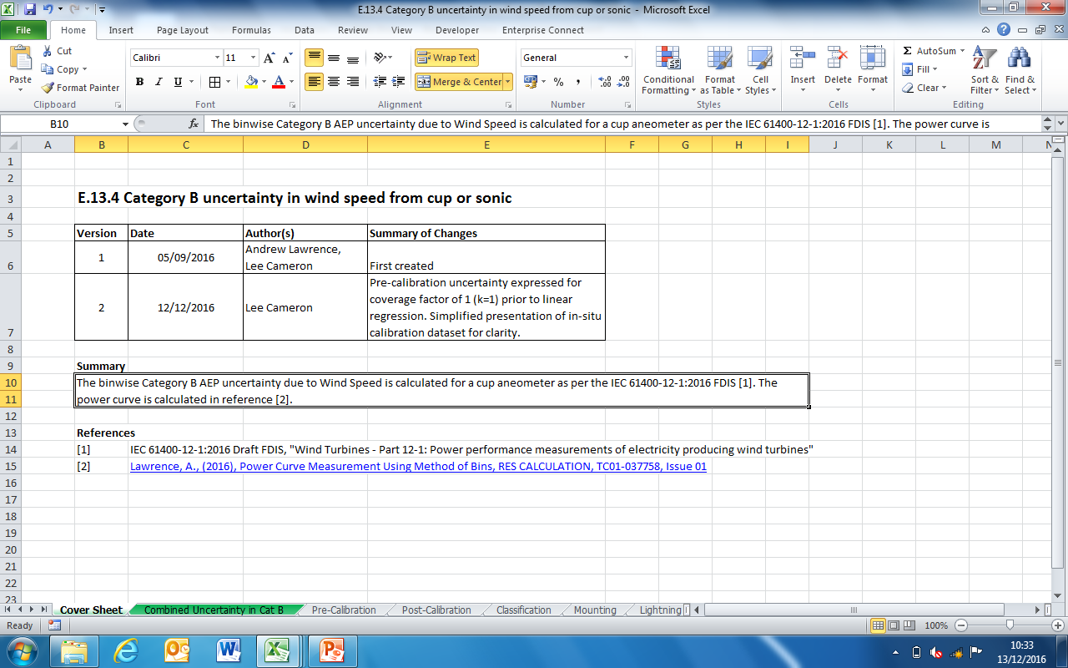
PCWG Feedback
These issues are being addressed and version 2 of the spreadsheets will be added to the DropBox for final review by PCWG members soon
They will then be open-sourced via the PCWG website

Slide 22
REFERENCES
[1] Lawrence, A., (2016), Power Curve Measurement Using Method of Bins, RES CALCULATION, TC01-037758, Issue 01
[2] Lawrence, A., (2016), Site Calibration Using Linear Regression, RES CALCULATION, TC01-038042, Issue 01
[3] Cameron, L., (2016), E.2 Combining Uncertainties, RES CALCULATION, TC01-037849, Issue 01
[4] Lawrence, A., (2016), E.5 Category B Uncertainty in Electric Power, RES CALCULATION, TC01-037769, Issue 01
[5] Cameron, L., (2016), E.13.3 Category B Uncertainty in the Wind Speed Measurement.xlsx, RES CALCULATION, TC01-037880, Issue 01
[6] Cameron, L., (2016), E.10 Category B uncertainty in Air Density, RES CALCULATION, TC01-037869, Issue 01
[7] Cameron, L., (2016), E.13.15 Category B Uncertainty Calculation for Method related components, RES CALCULATION, TC01-037863, Issue 01
[8] Cameron, L., (2016), E.13.4 Category B uncertainty in wind speed from cup or sonic, RES CALCULATION, TC01-037795, Issue 01
[9] Cameron, L., (2016), E.13.5 Category B uncertainty in wind speed from RSD, RES CALCULATION, TC01-037792, Issue 01
[10] Cameron, L., (2016), E.13.11 Category B uncertainty in wind speed from flow distortion due to terrain, RES CALCULATION, TC01-037833, Issue 01
[11] Cameron, L., (2016) E.13.6 Categiry B uncertainty in wind speed from REWS, RES CALCULATION, TC01-037812, Not yet issued

Slide 23
Reflections
The new standard is much more complicated than the previous version
More potential measurement setups allowed
More sophisticated analysis methods (e.g. REWS, turbulence renormalisation)
The uncertainty annex is “informative”
It is not a firm set of rules but gives guidance on how to perform uncertainty calculations
Often sections are open to interpretation
RES will open source these workbooks through PCWG website to guide the industry on how to sensibly interpret the uncertainty annexes
The standard is not complete
Some typos, incompatible units in equations etc.

Slide 24
Presentation Contents
Power Performance Test Procedure
Power Curve Uncertainty Consensus Analyses
Project Plan
Uncertainty calculations
Combination of components,
Category A uncertainties
Category B uncertainties
Map of the consensus analysis workbooks
PCWG Feedback
Conclusions

Slide 25
Simplistic Power Performance Test Procedure
Before the turbine is built, we erect two masts (or RSDs?)
One were the turbine will be located
One at a distance approximately 2.5 rotor diameters away
The data we collect allows us to establish a relationship in wind speed between the two locations
This is known as the site calibration phase

Slide 26
Simplistic Power Performance Test Procedure
Then the “turbine mast” gets knocked down, and a turbine is erected
We can infer the turbine location wind speed from the reference mast and the site calibration relationship
The concurrent power and wind speed data (after filtering for wakes etc.) forms the power curve test dataset

Slide 27
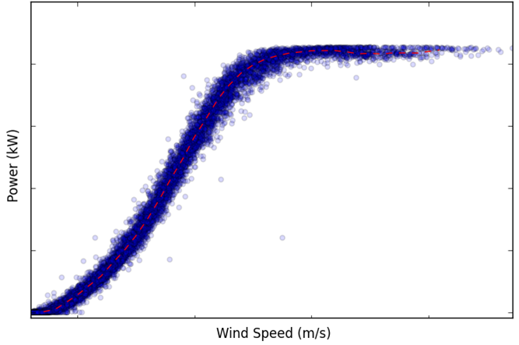
Simplistic Power Performance Test Procedure
The test dataset is binned by wind speed
Normalisation such as density and turbulence correction can also be performed
The mean power in each bin is calculated to give the measured power curve
Notes:
Data normalisation = density, turbulence and shear corrections

Slide 28
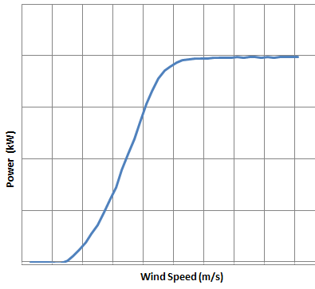
Simplistic Power Performance Test Procedure
Multiply the power curve by a long term WS distribution to calculate the Annual Energy Production (AEP):
X
Notes:
Data normalisation = density, turbulence and shear corrections

Slide 29
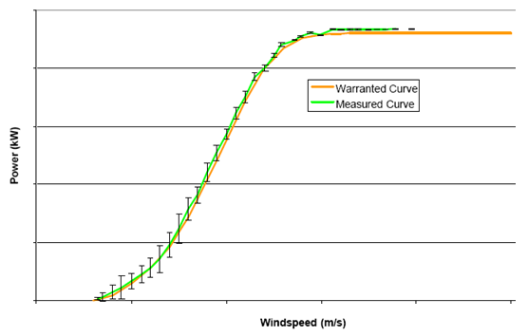
Simplistic Power Performance Test Procedure
Calculated the uncertainty associated with the measured power curve, and hence the estimated AEP.
Is the manufacturer’s guaranteed performance being met in reality (within the uncertainty of the test)?
Notes:
Data normalisation = density, turbulence and shear corrections

